Slide 1
FRAMES 1.3
OVERVIEW
Introduction
The reference provides general explanations regarding the functionality and usability of FRAMES. It also elaborates on specific examples shown in the Tutorial, and serves as a wonderful complementary to the Tutorial. Use the table of contents to locate information regarding general topics.
Reference Section Features
To view the previous page, click on the ( ) button.
To view the next page, click on the ( ) button.
To end the reference section and return to the main FRAMES page, click on the ( ) button
To return to the reference section Table of Contents, click on the ( ) button.
If the navigation buttons below are grayed out ( ), it means that it has been disabled
A # of # at the bottom of the page, between the navigation buttons, indicates the user’s progression through a specific section
Reference

Slide 2
TABLE OF CONTENTS
BUILDING A SCENARIO – The general outline in building the most basic scenarios
OPENING/SAVING A NEW CASE (GID FILE) – Introduces GID files, and how to work with them.
ICON DESCRIPTION – Gives detailed explanations as to what each icon stands for, and infomration on the module
ICON IDENTIFICATION – General steps regarding icon names, labels, and identification
INSERTING/ARRANGING ICONS – How to drag/drop/move icons within the CSM
CONNECTING/DISCONNETCING ICONS – Describes the different functionality of linkages between icons.
THE LIGHTING SYSTEM – Explains the lighting system and what each color indicates.
SETTING UP A MODEL – Selecting a model, inputting data, and running a model
VIEWING RESULTS – Gives general guidelines in selecting a viewer, and viewing the results of a case
CUSTOMIZING THE WORKSPACE – Explains the “Customize Menu” and the functionality of each option
PRINTING A SCENARIO – General steps in how to print a scenario
GLOSSARY – Alphabatized list of common terms and acronyms used in association with FRAMES.
Reference

Slide 3
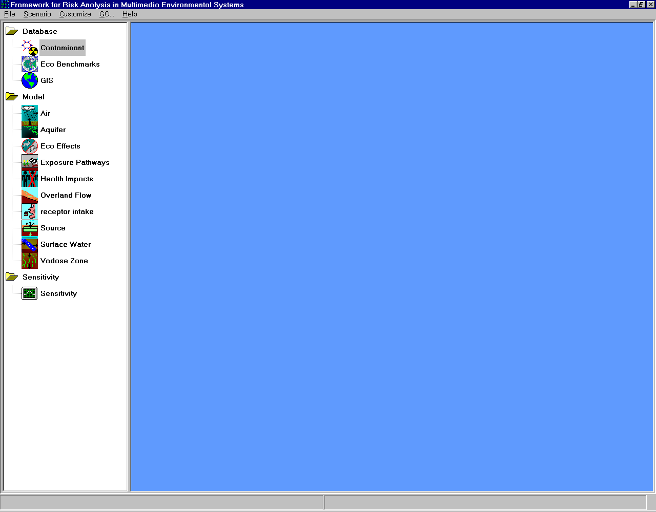
BUILDING A SCENARIO
First step in building a scenario is to gather all the necessary icons. Each icon located on the FRAMES toolbar represents a module to be linked together to model the site. Different icons may appear in the toolbar based on the modules included in the version of FRAMES installed on your computer. For more details on icons, refer to the icon description section.
The main screen is a Conceptual Site Model (CSM) and shows the flow of contamination across the site being modeled through the linked icons. The CSM defines the "real world" problem in a simplified way to conduct analysis. The problem is completely defined through the CSM including release scenarios, source characteristics, release mechanisms, transport pathways, exposure routes, risk end points and risk metrics.
GENERAL STEPS IN BUILDING A SCENARIO
1) Gather necessary icons to simulate the scenario
2) Insert them into the CSM
3) Arrange icons in a logical layout that simulates the flow of contamination
4) Connect icons in the order that contamination flows through them
Menubar
Icons. Each represents a module to be linked to model the site.
Toolbar
Figure 3.1 Conceptual Site Model (CSM)
Scenario

Slide 4
BUILDING A SCENARIO
5) For each icon, select a model
6) For each icon, enter in data input
7) Run each icon
8) Select a viewer for results
Scenario

Slide 5
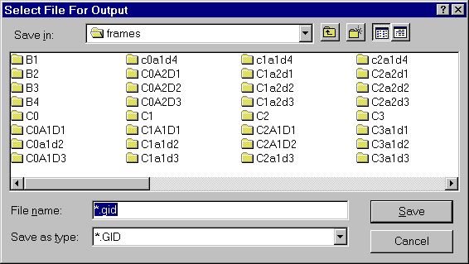
OPENING/SAVING A CASE (GID FILE)
After opening FRAMES, the Main Screen will appear, characterized by a gray background.
To begin a new FRAMES case, a GID file must be opened. This can be an already existing file or a new file.
CREATING A NEW GID FILE
To begin building a new case, a new GID file must be created. A GID is simply the file extension used for the user input file which is used for FRAMES. To create a new GID, click on the file menu (from the menu bar) and choose “New.” The “Select File For Output” window (Figure 3.2) will open, prompting the user to name the new file and place it under an appropriate folder. Though the FRAMES directory is shown in the figure below, it is not necessary to save GID files within the FRAMES directory. Click “Save” when finished.
OPENING AN EXISTING GID FILE
To open and work on an existing case, click on the file menu
and choose “Open.” A window, similar to the one shown in
the figure below, titled “Open,” will appear, allowing the
user to choose the desired file to open. Click “Open” after
selecting the file to open.
SAVING A GID FILE
It is best to periodically save a GID file as to prevent loss of
changes due to technical errors. To do this, click on the File
menu and choose “Save.” FRAMES will automatically save
any additional changes made from the pervious save.
FRAMES will also prompt the user to save the GID file when
the file is closed, or if a new file is being opened.
Figure 3.2 Select File For Output Screen
GID files

Slide 6


MODULE ICON DESCRIPTIONS
Below, are the icons used within FRAMES.
ATMOSPHERIC TRANSPORT
The FRAMES atmospheric component for air media includes models for emission from a source to the air, initial plume rise and dispersion, airborne pollutant transport and dispersion, and deposition to soils and crops.
Typically, this module takes in Air Flux File (AFF), Global Input Data (GID), and produces Atmospheric Transport Output file (ATO).
EXPOSURE PATHWAY
Ingestion exposure pathways include ingestion of drinking water, ingestion of water while showering, ingestion of agricultural products (leafy vegetables, other vegetables, meat, and milk), ingestion of aquatic foods (fin fish and shellfish), ingestion of water or sediment while participating in aquatic recreational activities (swimming, boating, or shoreline use), ingestion of soil, and ingestion of special foods (for which measured pollutant concentrations are available). Dermal exposure pathways include contact with soil, shoreline sediments, and water (while swimming or showering). Inhalation exposure pathways include inhalation of air transported from the release site to the exposure location, inhalation of resuspended particulate material from soil, and inhalation of volatile pollutants released from shower water or other domestic water uses. External exposure may occur from proximity of individuals to radionuclides on ground (deposited from air, deposited onto shoreline sediment, or for measured soil concentrations), in water (swimming and boating), or in air (submersion in a passing plume). The direct radiation dose rate measurement pathway is also an external exposure route.
Typically, this module takes in Source Concentration file (SCF), Water Concentration file (WCF), Atmospheric Transport Output file (ATO), Global Input Data file (GID), and produces Exposure Pathway file (EPF)
Descriptions

Slide 7



MODULE ICON DESCRIPTIONS
HUMAN HEALTH IMPACTS
Health impact models are used to estimate the health impacts from exposure to the pollutant of concern. Models are defined for noncarcinogenic chemicals, carcinogenic chemicals, and radionuclides and radiation dose. When populations are exposed to carcinogenic pollutants, including radiation, estimates of health impacts to an exposed population may also be made by multiplication of the effect to an average member of the population by the number of people in the exposed population.
Typically, this module takes in Intake Pathway File Format File, Global Input Data file (GID), and produces Health Impacts File Format
OVERLAND
Typically, this module takes in Water Flux File (WFF), Global Input Data file (GID), and produces Source Concentration File (SCF), Water Flux File (WFF).
RECEPTOR INTAKE
The average daily dose of a pollutant for an exposure pathway involves consideration of the rate of intake (ingestion, dermal absorption, inhalation, or external radiation dose), the frequency of exposure, the exposure duration, the averaging time, and the body weight of the exposed individual or an average member of the population.
Typically, this module takes in Exposure Pathway File Format, Global Input Data file (GID), and produces Intake Pathway File Format.
Descriptions

Slide 8


MODULE ICON DESCRIPTIONS
SATURATED ZONE
The groundwater component of FRAMES models solute transport through the groundwater environment (i.e., partially saturated and saturated zones). Specifically, this component provides estimates of groundwater contaminant fluxes at various transporting medium interfaces (e.g., water table or aquifer/river interface) and contaminant concentrations at withdrawal wells. Contaminant fluxes at transporting medium interfaces represent boundary conditions for the next medium in which contaminant migration and fate is to be simulated (e.g., groundwater contamination entering a surface-water environment). Contaminant concentrations at withdrawal wells provide contaminant levels for the exposure assessment component of FRAMES.
Typically, this module takes in Water Flux File (WFF), Global Input Data file (GID), and produces Water Concentration File (WCF), Water Flux File (WFF).
SOURCE TERM
The FRAMES source-term release module includes models for estimating contaminant loss from three different types of source zones: contaminated aquifer, contaminated pond/surface impoundment, and contaminated vadose zone. In all types of contaminant source zones, it is assumed that the contaminants may be present in multiple phases (i.e., in aqueous solution, sorbed to solid particles, in vapor-filled pore space, or in a separate non-aqueous-phase liquid [NAPL] that is immiscible with water and air). The source-term release module contains models to determine which contaminants in the problem scenario will partition into which phases, and to what degree. Depending on the type of source zone, it is assumed that the processes causing contaminant release from the source zone to an environmental transport pathway could be leaching (groundwater pathway), wind suspension (atmospheric pathway), water erosion (overland/surface water pathway), overland flow (overland/surface water pathway), and/or volatilization (atmospheric pathway). In addition, contaminants could be lost from the source zone by radioactive decay or degradation within the zone.
Typically, this module takes in Global Input Data file (GID), and produces Source Concentration File (SCF), Air Flux File (AFF), Water Flux File (WFF).
Descriptions

Slide 9


MODULE ICON DESCRIPTIONS
SURFACE WATER
Of the many types of surface water bodies (e.g., nontidal rivers, estuaries, lakes, open coasts, reservoirs, impoundments, etc.) in which contaminant fate and transport could be simulated, only a nontidal river model is currently incorporated. Nontidal rivers refer to freshwater bodies with unidirectional flow in definable channels.
The surface water component provides estimates of contaminant concentrations in a river at locations downstream from a release point. The computed contaminant concentrations are used by the exposure assessment component of FRAMES to calculate dose and the resulting health effects to the surrounding population. Potential exposure of humans to contaminants via rivers can be associated with ingestion (e.g., drinking contaminated water), inhalation of volatile pollutants (e.g., showering), dermal contact to chemicals (e.g., swimming), or external dose from radionuclides (e.g., swimming).
Typically, this module takes in Water Flux File (WFF), Global Input Data file (GID), and produces Water Flux Files (WFF)
VADOSE ZONE
The Vadoze Zone module models contaminant behavior in the subsurface above the ground water; may receive input from source modules; provides input to the aquifer module. There are different types of Vadose Zone including silt and clay. To model the site, more than one vadose module can be attached to the case demonstrating the differing levels of subsurface.
Typically, this module takes in Water Flux File (WFF), Global Input Data file (GID), and produces Water Flux File (WFF).
Descriptions

Slide 10

MODULE ICON DESCRIPTIONS
GROUND WATER
The Aquifer Module also known as the Saturated Zone Module simulates the movement of solutes through saturated porous media.
SENSITIVITY UNCERTAINTY
To conduct sensitivity or uncertainty analysis on the module input values, place a Sensitivity module on the workspace.Then connect it to all modules that you are interested in either stochastically running the inputs or would like the outputs to be reported.
Descriptions

Slide 11
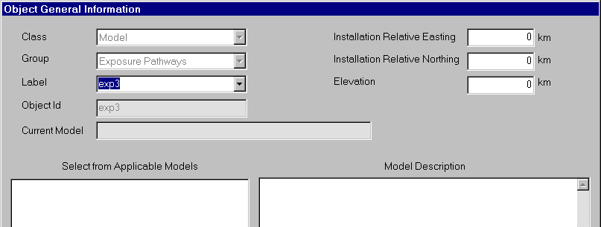
ICON IDENTIFICATION
When the icons are placed on the screen, a computer-generated label is automatically added. The label is based on an abbreviation for the type of module and a number for the order in which the icons were placed on the main screen. In the Tutorial, the individual icons will be referred to by the computer-generated label. The computer-generated name (usually referred to as “icon name”), and the custom name (usually refered as “icon label), should not be confused.
These labels can be customized when the module is selected. The user can display both the computer-generated name and the custom name by clicking on 'Customize' located on menu at the top of the main FRAMES screen and selecting ‘Show Object Id’.
To change the custom name of the icon, right click on the icon and select “General Info” from the pop up menu. This will lead you to the Object General Information screen, which allows the user to change the icon label (custom name), as shown in Figure 3.
Rename the icon here
Figure 3.11.2 Object General Information Screen
Icons

Slide 12
INSERTING AND ARRANGING ICONS
INSERTING ICONS INTO THE CSM
After all necessary icons have been decided, they need to be inserted into the CSM. To insert an icon, double click the desired icon from the toolbar on the left side. The icon should appear on the right hand side of the screen, in the CSM.
ARRANGING ICONS WITHIN THE CSM
It is a good idea to arrange the icons in a more logical way so that it accurately simulates the flow of contamination. To move an icon, click on the icon and drag the cursor to the desired location. Release the mouse.
Icons

Slide 13
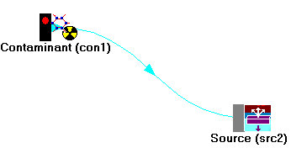
CONNECTING ICONS
CREATING A LINKAGE
The icons should be linked in order of the flow of contamination. To link two icons together, hold down the shift key, then left click on the icon while dragging the cursor from one icon to the next.
REMOVING A LINKAGE
The link can be removed in the same manner by holding down the shift key and dragging the mouse between icons.
DELETING A LINKAGE
To delete a link, right click on the icon and choose “delete.”
Any number and direction of connections is permitted between icons, however certain modules may limit the connections. Linkages may be added or removed at any point in the scenario, however changing a linkage may affect the selected module. When deleting a linked icon from the screen, the attached linkages will automatically be deleted also and do not need to be deleted separately.
Icons

Slide 14
STATUS LIGHTS
The black side bar on the icon is a signal light. It changes color every time a step is completed.
No model selected
After naming an icon and selecting the applicable model, the light on the black side bar should be RED.
No data entered
After entering all data in the User Input section and confirm that all the parameters are green, the light on the black side bar should be YELLOW.
Data Entered
When data entry is finished, and models have been run, every model will run in a MS-DOS screen before returning to the main FRAMES window. Only then will the icon with the black side bar have a GREEN signal light. Databases unlike models, do not need the third option (Run Model) selected on the right-click pop up menu, so the yellow light never appears for the Contaminant icon.
Data entered, module successfully run
Status Lights

Slide 15
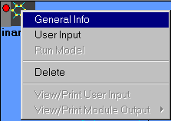
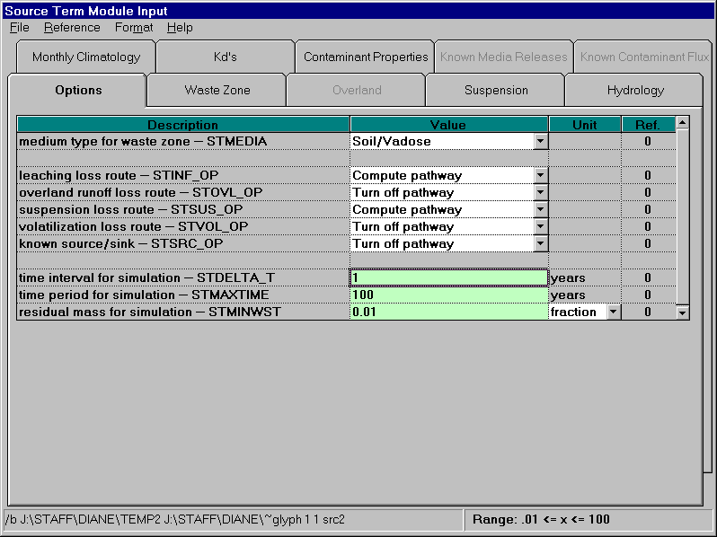
SETTING UP A MODEL
SELECTING A MODEL
To select a specific model from a module type icon, first ensure that all module connections are complete,
then right-click on the icon (see Figure 3.3) and choose “General Info.” The model selection screen will
appear. (Note: This is the best time to name the icon. For more details, go to the icon identification section.)
If the model was selected correctly, the status light will be red.
INPUTTING DATA INTO A MODEL
To input data into a model from a module type icon, right-click and
choose “User Input.” The model’s specific user interface will appear.
Boxes will be shaded either red or green. A red box signifies missing
information that needs to be filled in. The user will be unable to
continue if red boxes are not filled in. A green box signifies that the
data is acceptable.
The user must also make sure that the inputted values are within
its numeric value range. This can be found at the bottom of the
screen, once the cursor is placed inside of the box.
Once the data is entered completely, the status light will
be yellow. For more details on the lighting system, click here.
Figure 3.3 Right Click on Icon
Figure 3.4 Numerical value range for each box
Model Input

Slide 16
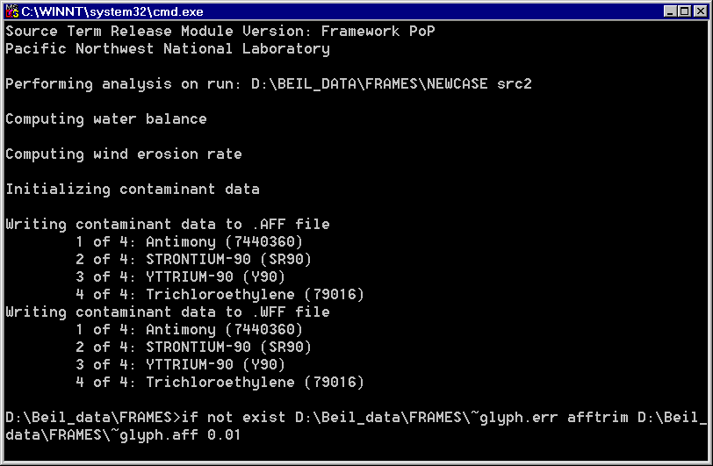

RUNNING A MODEL
To run each model separately, right-click on the module icon and choose “Run Model.” The FRAMES user interface will close and the model will run in a MS-DOS screen (Figure 3.4) before returning to the main FRAMES window. The “GO” button serves as an alternative way to run models.
After inputting data into all modules (when all modules have yellow lights), click the “GO” button located on the toolbar (Figure 3.5). This will automatically run all modules within the CSM.
Figure 3.5 Model runs in MS-DOS screen
The “GO” button
Figure 3.6 Runs all models
Model Run

Slide 17
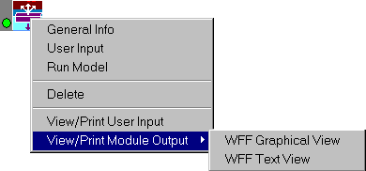
VIEWING RESULTS
The FRAMES user interface provides viewers that allow users to view text and graphical information produced by modules that meet the FRAMES data file specifications. Viewers and chart viewers are available to view .WFF, .WCF, .SCF, .EPF, .RIF, and .HIF files.
To view results, the signal light on the module must be green, signaling the run has been completed. Right-click on the module icon and select “View/Print Module Output” from the popup menu (see Figure 3.6). Select the desired viewer from the View/Print Module Output list. There are at least two choices for each viewer attached to a module: a graphical and text viewer. To see the results in the various viewers, reselect a different viewer.
There are at least two choices for each viewer icon attached to a module: a graphical and text viewer. The graphical viewer shows a graph of the results, and the text viewer is a text file of the results. For those who like to see what the results of all input data look like, the graphical viewer is a better choice while the text viewer will only give information.
Right click again on the viewer icon and select ‘Run Model.’ The Viewer will open the results file. You can attach many viewer icons and view the results for each file in a separate icon, or after viewing the results disconnect the icon from the module and redraw the line to a different module. Then right click on the icon and change the ‘General Info’ to a different chart or viewer.
Figure 3.7 Right Click on Icon
Results

Slide 18
VIEWING RESULTS
The following tables provide a specific list of applicable viewers and file extensions.
MODULE
APPLICABLE VIEWERS FOR THE MODULE
Source Term
AFF Chart, AFF Viewer, WFF Chart, WFF Viewer
Vadose Zone
WFF Chart, WFF Viewer
Ground Water
WCF Chart, WCF Viewer, WFF Chart, WFF Viewer
Surface Water
WCF Chart, WCF Viewer
Atmospheric Transport
ATO Viewer, GNUPLOT Concentrations
Exposure Pathway
EPF Chart, EPF Viewer
Receptor Intake
RIF Chart, RIF Viewer
Human Health Impact
HIF Chart, HIF Viewer
Sensitivity Uncertainty
SUF Chart, SUF Viewer
FRAMES file extensions:
AFF – Air Flux File | ATO – Atmospheric Transport Output File | EPF – Exposure Pathways File | ERR – Error File | GID – Global Input Data File | HIF – Health Impacts File | RIF – Receptor Intakes File | SCF – Soil Concentration File | SUF – Sensitivity Uncertainty File | WCF – Water Concentration File | WFF – Water Flux File
Results

Slide 19
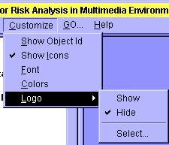
CUSTOMIZING THE WORKSPACE
The font, background color and linkage color can all be customized.
To customize the screen, click on the ‘Customize’ menu (see Figure 3.7) located on the top menu bar.
Figure 3.8 Customize menu
SHOW OBJECT ID (IDENTIFICATION)
Click on “Show Object ID” to show the object ID or not. The object ID is usually a cryptic number and letter combination such as src2. For more information regarding icon ID, refer to the Icon Identification section. The object ID is also the same as the default label that is given to the icon when the icon is first inserted into the CSM.
SHOW ICON
Click on “Show Icon” to view the module icon as well as the text, or simply view the text. This option only affects the module type outline on the left side of the screen.
FONT
Click on “Font” to customize the font, style, and size of text within the FRAMES Interface
Customizing

Slide 20
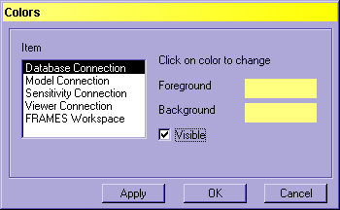
CUSTOMIZING THE WORKSPACE
COLOR
Click on “Color” to customize the color of the background, text, and linking arrows for the FRAMES Interface (see Figure 3.8). The options for customizing linkages include Database Connection, Model Connection, Sensitivity Connection, and Viewer Connection. Click on the item on the left side of the screen shown in Figure 4, then click on the foreground and background color to change. The Visible box should be checked as the default, but may be unchecked if so desired.
LOGO
Click “Logo” to show or hide the Logo. In addition, this feature allows the user to select the logo to use from a file. In the upper left corner of the FRAMES screen, above the Icon toolbar, an optional logo can be shown. Click the Customize menu from the menu bar and select Logo > Select. The file selection menu will open with all picture files shown (i.e., *.jpg, *.bmp, *.ico). Select one of the pictures from the list in the default FRAMES folder, or use a user created picture file. Click Open and the new logo will be displayed. To hide the logo, select Logo > Hide.
Figure 3.9 Colors Customize menu
Customizing

Slide 21
PRINTING A SCENARIO
Once the scenario is complete, the components can be printed to a file or printer for documentation.
Click on the File menu from the menu bar and select Print. The Print form will display all modules for all scenarios and checkboxes for the user to select which components to print.
Click the Preview checkbox to see what will be printed before actually doing so. As you change selections, the contents of the preview panel will change.
Click Print to select a Printer and set print options.
Click Print again to print the document. If you have checked Print to File you will be prompted to select or name the output file; click Open to confirm or Cancel.
Confirm the Print to File by opening the output file with a word processor to verify the contents. Click Close to return to the FRAMES screen.
Print

Slide 22
GLOSSARY
The following terms and acronyms, which are listed in alphabetical order, are used in the FRAMES software.
To open this file as a Microsoft Word document, with an additional list of acronymns and abbreviations, click here.
To open this file as a WordPerfect document, with an additional list of acronymns and abbreviations, click here.
aerated tank source module—module within the Multimedia Multipathway Simulation Processor that models the release of contaminants from an aerated tank; for modeling purposes, the only environmental release mechanism assumed for this source type is volatilization of contaminants to the air; provides input to the air module only.
air module—fate and transport module within the Multimedia Multipathway Simulation Processor that models contaminant transport through the air pathway; receives input from the source modules; may provide input to the watershed module, the surface water module, the farm food chain module, the terrestrial food chain module, and the human exposure module.
aquatic food chain module—food chain module within the Multimedia Multipathway Simulation Processor that simulates contaminant movement through the water-based food chain; receives input from the surface water module; may provide input to the ecological risk module, ecological exposure module, and the human risk module.
aquifer module—fate and transport module within the Multimedia Multipathway Simulation Processor that models contaminant behavior through the ground water; receives input from the vadose zone module; may provide input to the surface water module, farm food chain module, and human exposure module.
assumption—statement regarding the scientific basis of how a computer program models a real-world activity or occurrence.
chemical properties database—collection of data on properties of chemicals of interest, including such information as molecular weight and density.
Chemical Properties Processor—processor that gathers appropriate chemical properties data from the chemical properties database to supply necessary information to the Site Definition Processor and modules within the Multimedia Multipathway Simulation Processor.
compiler—computer program that converts higher-level language to machine language to allow easier sharing of information between programs; adds instructions and subroutines to the original program.
Computational Optimization Processor—processor that assimilates the exposure and risk scenario as contained in the Site Definition Files and establishes, based on specific rules, a modified scenario that is technically complete and computationally efficient.
Glossary

Slide 23
GLOSSARY
data file—collection of data generated by the FRAMES-HWIR Technology Software System arranged for ease of retrieval by various computer programs.
data group—collection of related parameters (for example, data describing site atmospheric conditions) within a database or data file.
Data Processor II—processor developed by EPA to access appropriate data from the MET (meteorological) database for modules in the Multimedia Multipathway Simulation Processor.
design—noun: comprehensive description of how a piece of software will function (that is, how it will meet its requirements); hence, a design document includes such a description.
verb: to identify how a piece of software will function and meet its requirements; hence, we design a piece of software by writing down the description. In either case, for the FRAMES-HWIR Technology Software System, design includes short-term, as well as longer-term, capabilities of the software.
development—process of programming to meet user requirements as specified in the software design.
directory—collection of files and subdirectories.
Distribution Statistics Processor—processor that randomly samples from statistical distributions representing measurement variability and sampling error related to the statistics of parameters required by the models (for example, distribution, mean, standard deviation, and range).
dynamic link library—modular set of routines that link to their calling programs at run time rather than during compilation; standardizes a common set of routines used by more than one program.
ecological exposure module—exposure module within the Multimedia Multipathway Simulation Processor that calculates exposure to ecological receptors; may receive input from the terrestrial food chain module and the aquatic food chain module; provides input to the ecological risk module.
ecological risk module—risk module within the Multimedia Multipathway Simulation Processor that calculates risk (or hazard quotient) to ecological receptors; receives input from the ecological exposure module; provides input to the exit level processor.
Glossary

Slide 24
GLOSSARY
executable—self-contained set of coded instructions designed to process and control a particular component of the FRAMES-HWIR Technology Software System.
Exit Level Processors—processors that use the individual site simulations generated by the Multimedia Multipathway Simulation Processor to tabulate information for determining levels of protection on the exit criteria for contamination; ELP I produces the Risk Summary Output File; ELP II takes the Risk Summary Output File and generates the Protective Summary Output File. The Risk Summary Output File becomes input to the Risk Visualization Processor. The two files generated by the ELPs contain site-based exposure and risk information that is used to establish a national distribution of risks. The national distribution of risks, and all related data, forms the technical basis for EPA to select chemical-specific levels for each source type.
exposure and risk modules—modules within the Multimedia Multipathway Simulation Processor that calculate risk numbers or hazard quotients for either human or ecological receptors; includes human exposure module, ecological risk module, ecological exposure module, and human risk module.
farm food chain module—food chain module within the Multimedia Multipathway Simulation Processor that simulates contaminant movement through a farm-related food chain; may receive input from the aquifer module, air module, and surface water module; provides input to the human exposure module.
fate and transport modules—modules within the Multimedia Multipathway Simulation Processor that simulate contaminant behavior through a sequence of environmental media; include air module, watershed module, vadose zone module, aquifer module, and surface water module.
file—see data file.
food chain modules—modules within the Multimedia Multipathway Simulation Processor that simulate contaminant movement through a particular food web to human or ecological receptors; include farm food chain module, aquatic food chain module, and terrestrial food chain module.
FRAMES-HWIR Technology Software System—name of the technology being developed to automate EPA’s HWIR Assessment Strategy; FRAMES in this context stands for Framework for Risk Analysis in Multimedia Environmental Systems and is a software system developed by the Pacific Northwest National Laboratory for the U.S. Department of Energy.
geographic reference point—latitude and longitude used to locate a site geographically; the point is translated into Universal Transverse Mercator (UTM) coordinates to facilitate location of various physical entities (for example, streams and receptors) at a site.
Glossary

Slide 25
GLOSSARY
Global Results Files—collection of data groups populated by execution of appropriate models in the appropriate sequence in the Multimedia Multipathway Simulation Processor and used to provide input to the Exit Level Processors. Each site and each pathway of exposure has a Global Results File; these files are stored in a common directory.
human exposure module—exposure module within the Multimedia Multipathway Simulation Processor that models how humans might be exposed to contamination through various environmental pathways; may receive input from the aquifer module, air module, surface water module, farm food chain module, and aquatic food chain module; provides input to the human risk module.
human risk module—risk module within the Multimedia Multipathway Simulation Processor that simulates human health impact that might result from exposures by human receptors to contamination in environmental pathways; receives input from the human exposure module; provides input to the exit level processor.
HWIR Assessment Strategy—scientific approach used for the EPA initiative to assess hazardous waste sites for the potential to exit Industrial Subtitle D status for particular waste streams. The HWIR Assessment Strategy is documented in the draft report (Marin and Saleem 1997) A Preliminary Framework for Finite-Source Multimedia, Multipathway, and Multireceptor Risk Assessment (3MRA).
HWIR Input/Output Dynamic Link Library—modular set of routines to simplify the interface between existing and new codes; provide a flexible and expandable storage format for input and output.
HWIR Monte Carlo Dynamic Link Library—modular set of routines to simplify the interface between the Statistical DLL and the system components; allows the Statistical DLL to run with various compilers.
HWIR Statistical Dynamic Link Library—modular set of routines that facilitate the calculation of statistical parameters for several system components.
implementation—resource- and schedule-constrained translation of design into an operating software system.
input/output specifications—detailed descriptions of data and their format; necessary to allow processors and modules within processors to transfer information effectively with each other.
Glossary

Slide 26
GLOSSARY
land application unit source module—module within the Multimedia Multipathway Simulation Processor that models contaminant release from a land application unit; for modeling purposes, includes volatilization and particulate suspension to the air, leaching, and overland release mechanisms; utilizes two distinct models, one with input surface hydrology that will sample annual average values for infiltration, runoff, and evapotranspiration from regional distributions while estimating erosion on an annual average based on a random sampling of appropriate parameters; one with simulated surface hydrology that will function at the source and reflect a precipitation event-based methodology using daily meteorological data and source surface cover data to simulate infiltration, runoff, evapotranspiration, and erosion; may provide input to the air module, watershed module, and vadose zone module.
landfill source module—module within the Multimedia Multipathway Simulation Processor that models contaminant release from a landfill; for modeling purposes, includes volatilization and particulate suspension to the air, leaching, and overland release mechanisms; utilizes two distinct models, one with input surface hydrology that will sample annual average values for infiltration, runoff, and evapotranspiration from regional distributions while estimating erosion on an annual average based on a random sampling of appropriate parameters; one with simulated surface hydrology that will function at the source and reflect a precipitation event-based methodology; uses daily meteorological data and source surface cover data to simulate infiltration, runoff, evapotranspiration, and erosion; may provide input to the air module, watershed module, and vadose zone module.
legacy code or legacy model—models or programs developed before the FRAMES-HWIR Technology Software System development effort that will be used to implement some portion of the HWIR Assessment Strategy and may require modification for efficient use.
limitation—a characteristic of a given model that bounds how results are estimated, provided, or interpreted.
location—the geographic reference point for a site in latitude/longitude coordinates (UTM coordinates will also be used).
Met (meteorological) database—collection of data related to meteorological phenomena at or near hazardous waste facilities.
model—noun: scientifically based computer calculations that simulate physical or physiological phenomena.
verb: to execute a set of scientifically based calculations to simulate physical or physiological phenomena.
model error statistics database—collection of data describing the likelihood of errors in particular scientific models used in the system; provides input to the Site Definition Processor.
Glossary

Slide 27
GLOSSARY
module—components within the Multimedia Multipathway Simulation Processor that, when collectively viewed and applied to a site, represent the modeling system for conducting exposure and risk assessment. A module comprises some combination or subset of model, pre-processor, post-processor, and module user interface. For the HWIR Assessment Strategy, modules include source modules, fate and transport modules, food chain modules, and exposure and risk modules.
Module Execution Manager—component within the Multimedia Multipathway Simulation Processor that manages the flow of information within the modules, as well as the storage of information.
Multimedia Multipathway Simulation Processor—implements the release, transport, exposure, and risk/hazard assessment modeling protocol by choosing and linking the appropriate models to supply results to the Exit Level Processors; consists of a Module Execution Manager and a collection of individual software modules each representing one of the fundamental elements of the risk assessment process (see module).
output specifications—see input/output specifications.
overland pathway—potential route of contamination from the waste management unit to a human or ecological receptor through environmental media.
parameter—an input or output value associated with calculations in a model or module.
processor—program within the FRAMES-HWIR Technology Software System (that is, Distribution Statistics Processor, Site Layout Processor, Site Definition Processor, Chemical Properties Processor, Computational Optimization Processor, Multimedia Multipathway Simulation Processor, Risk Visualization Processor, and Exit Level Processors) that results in a series of changes to data or data groups to support the HWIR Assessment Strategy.
program—a computer procedure for solving a problem, including collecting data, processing, and presenting results.
Protective Summary Output File—collection of data generated by the Exit Level Processor II to show a range of levels at which a chemical concentration would be considered to provide minimal impacts to human health and the environment. (Note the term protective has yet to be defined.)
regional/national environmental setting distribution statistics databases—collection of data containing stochastic parameters (a subset of the Site Definition File data) whose stochastic characteristics are themselves described with statistical distributions; one database contains information on environmental parameters collected for specific regions of the country identified by latitude/longitude descriptions; the other contains information on environmental parameters at a national level; data are used by the Distribution Statistics Processor.
Glossary

Slide 28
GLOSSARY
regional/national static databases—collection of data containing individual parameters (a subset of the Site Definition File data); one database contains information on environmental parameters collected for specific regions of the country identified by latitude/longitude descriptions; the other contains information on environmental parameters at a national level; data are used by the Site Definition Processor.
regional/national statistics databases—collection of data containing individual parameters (a subset of the Site Definition File data) with statistical distribution characteristics themselves described with statistical distributions; one database contains information on environmental parameters collected for specific regions of the country identified by latitude/longitude descriptions; the other contains information on environmental parameters at a national level; data are generated by the Distribution Statistics Processor for use by the Site Definition Processor.
requirements—characteristics and behaviors that a piece of software must possess to function adequately for its intended purpose.
Risk Summary Output File—collection of data generated by the Exit Level Processor I to summarize risk to human and ecological receptors under a variety of scenarios associated with a particular site and chemical.
Risk Visualization Processor—processor that generates graphical representations of various aspects of risk information; receives input from the Risk Summary Output File.
run—see simulation.
shared routine—computer program made available to other programs for use in conducting common tasks.
shareware—see shared routine.
simulation—a single execution of the Multimedia Multipathway Simulation Processor and associated processors in which the Multimedia Multipathway Simulation Processor executes the modules defined for that specific scenario.
site—for the purposes of the HWIR Assessment Strategy, an Industrial Subtitle D facility with one or more waste management units within a bounded area of approximately 20 km².
Site Definition Files—collection of data groups that result from executing the Site Definition Processor; provides input to the Computational Optimization Processor; represents a complete data set for implementation of the Multimedia Multipathway Simulation Processor.
Glossary

Slide 29
GLOSSARY
Site Definition Processor—the processor that organizes all data for input to the Site Definition Files by accessing databases containing all the necessary information and executing a hierarchical protocol to read these data files and extract the required data; it also provides the preliminary simulation plan and control information that could be used by the Multimedia Multipathway Simulation Processor.
site delineation database—collection of data describing environmental features at hazardous waste facilities, using a grid to locate key features; provides input to the Site Layout Processor to translate grid information for use in the site-based database.
Site Layout Processor—the processor that translates grid information related to environmental features at particular sites for use in the site-based database.
Site Simulation Files—collection of optimized data groups based on the Site Definition Files that result from execution of the Computational Optimization Processor for input to the Multimedia Multipathway Simulation Processor.
site survey database—collection of data describing latitude and longitude for each site being simulated.
source code—the original text version of a software program in a certain computer language. The source code is compiled into an executable format by the appropriate compiler.
source modules—modules within the Multimedia Multipathway Simulation Processor that model contaminant release for a particular source type: aerated tank, land application unit, landfill, surface impoundment, and waste pile.
spaghetti code—needlessly convoluted or complex code.
specification—detailed description of an interface to a computer program or set of subroutines allowing another programmer to develop a program that would make proper use of the subroutines.
surface impoundment source module—module within the Multimedia Multipathway Simulation Processor that models contaminant release from a surface impoundment; for modeling purposes, the only release mechanisms considered are volatilization to the air and leaching; may provide input to the air module and the vadose zone module.
surface water module—a fate and transport module within the Multimedia Multipathway Simulation processor that models contaminant behavior in surface waters such as streams, lakes and ponds; may receive input from the aquifer module, air module, and watershed module; may provide input to the aquatic food chain module, farm food chain module, and human exposure module.
Glossary

Slide 30
GLOSSARY
System User Interface—the interface that allows the user to interact with the system and connects, interacts with, and directs the other processors housed in the FRAMES-HWIR Technology Software System, managing the overall execution of the software system.
terrestrial food chain module—food chain module within the Multimedia Multipathway Simulation Processor that simulates contaminant movement through the terrestrial food web to ecological receptors; may receive input from the air module and surface water module; provides input to the ecological risk/exposure module.
test—an activity designed to assess the quality of a component. As applied to documents, tests consist of critical reviews. As applied to software, tests are specific cases executed to verify a requirement or uncover an error.
test plan—a detailed procedure for conducting a software test program. Test plans include a description of the component being tested, a summary of the requirements being tested, detailed descriptions of test cases, including the instructions necessary for conducting each test, and the expected results for each test to provide some criteria for deciding whether or not the test was successful.
transformation products—byproducts produced from chemicals as a result of environmental degradation.
vadose zone module—a fate and transport module within the Multimedia Multipathway Simulation Processor that models contaminant behavior in the subsurface above the ground water; may receive input from the land application unit, landfill, waste pile, and surface impoundment source modules; provides input to the aquifer module.
variable—an input or output parameter whose value can vary based on calculations in a model or module
waste management unit—a single source of contamination that could result in contaminant release to multiple environmental media; may include more than one of a single source type (for example, three aerated tanks in a grouping might be one waste management unit).
waste pile source module—module within the Multimedia Multipathway Simulation Processor that models contaminant release from a waste pile; for modeling purposes includes volatilization and particulate suspension to the air, leaching, and overland release mechanisms; utilizes two distinct models, one with input surface hydrology that will sample from regional distributions annual average values for infiltration, runoff, and evapotranspiration while estimating erosion on an annual average based on a random sampling of appropriate parameters; and one with simulated surface hydrology that will function at the source and reflect a precipitation event-based methodology using daily meteorological data and source surface cover data to simulate infiltration, runoff, evapotranspiration, and erosion; may provide input to the air module, surface water module, vadose zone module, and watershed module.
Glossary

Slide 31
GLOSSARY
watershed module—a fate and transport module within the Multimedia Multipathway Simulation Processor that simulates contaminant movement overland and through the interconnected creeks and rivers comprising a regional watershed; may receive input from land application, landfill, and waste pile source modules, and the air module; provides input to the surface water module.
To open this file as a Microsoft Word document, with an additional list of acronymns and abbreviations, click here.
To open this file as a WordPerfect document, with an additional list of acronymns and abbreviations, click here.
Glossary

